Slide 1

DISSERTATION ON EduHub - BVICAM Website (MCA – IV SEMESTER; BATCH 2022-24)
Internal Guide
Dr. Sunil Pratap Singh (Asst. Prof., BVICAM, New Delhi)
Presentation by
Nishika Kumar (02511604422)
Urvashi Rajpal (35111604422)
Vaibhav Aggarwal (35411604422)
02nd May 2024
Notes:
1

Slide 2
Contents
Problem Description
Aim and Objectives
Methodology and Technology Used for Project Development
Project Modules
Design Documents (Use Case, Data Flow Diagram, Entity-Relation Diagram, etc.)
Screenshots
Testing of Project
Conclusion
Future Scope
Bibliography

Slide 3
Problem Description
The college website currently faces several challenges that impact its overall effectiveness, user experience, and functionality.
The website exhibits an outdated design, which may result in a less engaging and intuitive user experience and mobile responsiveness. The website may not be optimized for mobile devices, resulting in a suboptimal experience for users accessing it from smartphones or tablets. Images, text, or interactive elements do not scale appropriately on smaller screens.
Outdated information is present on various sections of the website, including course details, faculty listings, and event calendars. Lack of a streamlined content management process for regular updates and maintenance. Developing an intuitive, and scalable platform with effective customer support adds complexity.
Reports of potential security vulnerabilities, posing risks to user data and the integrity of the website. A need for an updated security infrastructure to protect against potential threats. Along with it absence of a robust feedback mechanism for users to report issues, provide suggestions, or seek assistance. Limited channels for users to communicate problems to the website administrators.

Slide 4
Aim and Objectives
AIM
The primary aim of this project is to successfully transition the existing college website to the MERN stack – an advanced technology stack encompassing MongoDB, Express.js, React, and Node.js while ensuring accuracy, legality, and functionality.
OBJECTIVES
Tailor the website's layout and navigation to guide users, including students, faculty, and visitors. Employ user-friendly interfaces to enhance ease of use and ensure that users can quickly locate the information. Implement a responsive design to ensure a seamless and consistent user experience across various devices.
Ensure quick and easy access to essential information such as course details, academic calendars, faculty profiles, and campus resources.
Incorporate dynamic elements and interactive features to engage users, such as live event feeds, multimedia content, and real-time updates.

Slide 5
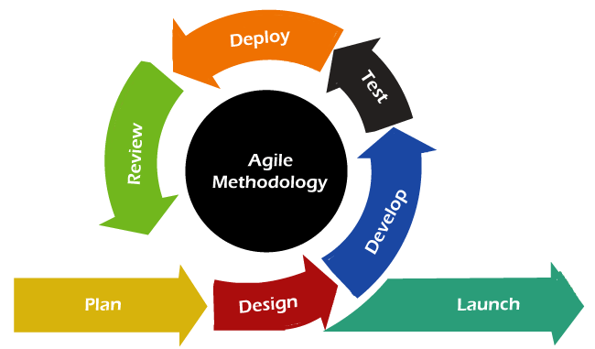
Methodology
Methodology used for Project Development:
Agile methodology, a dynamic software development approach, prioritizes iterative progress and collaboration with customers.
Projects are broken down into small sprints, typically lasting one to four weeks, fostering adaptability within cross-functional teams. Continuous feedback from stakeholders ensures alignment with evolving requirements.
Agile promotes transparency and early delivery of functional software.
It prioritizes individuals and interactions, valuing customer satisfaction and adaptability over strict adherence to plans.

Slide 6
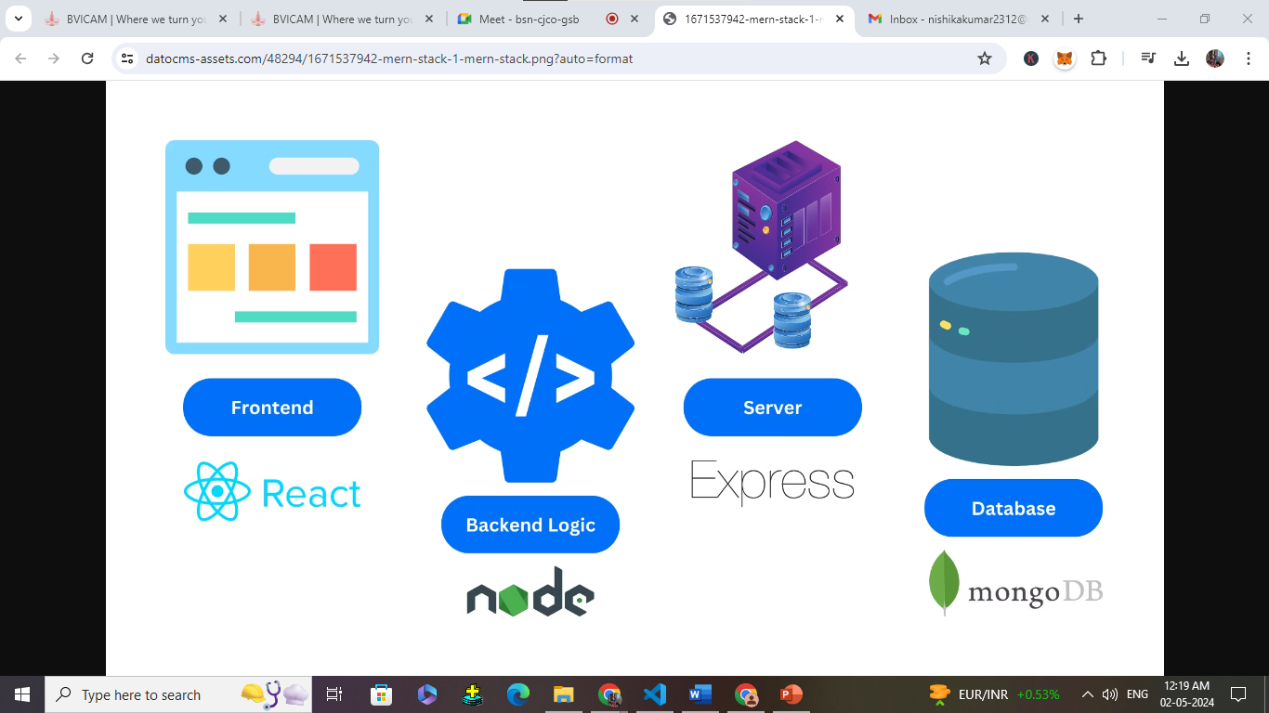
Technology
Technology used for Project Development:
Front-End: HTML v5.0, CSS, ReactJS v18.2.0
Back-End: NodeJS v18.18.2, Express v4.18.2
Integrated Development Environment (IDE): VS Code
Database: MongoDB 6.1.0

Slide 7

Project Modules
Course Module:
This module is designed to manage and display information about different courses and its subjects.
Notice Module:
This module focuses on the storage, retrieval, and display of notices on the website.
Image Module:
This module focuses on the storage, retrieval, and display of images on the website.
Faculty Module:
This module showcases information about the university's teams, departments, or organizational structure.
User Module:
The User module manages user-related functionalities, including authentication.
Contact Us Module:
This module facilitates user interaction and inquiries by providing a "Contact Us" or feedback form.

Slide 8
System Design

Slide 9
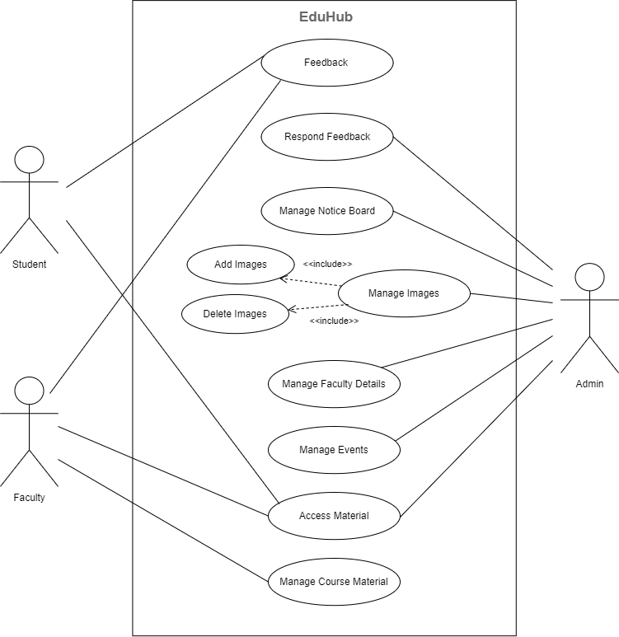
Use Case Diagram

Slide 10
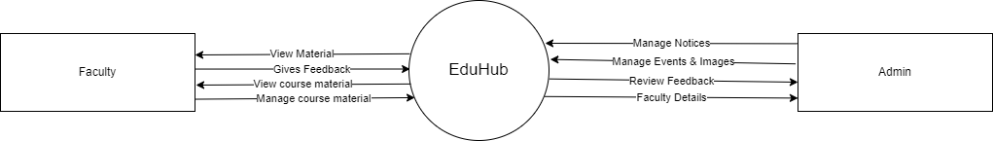
Data Flow Diagram (Level - 0)

Slide 11
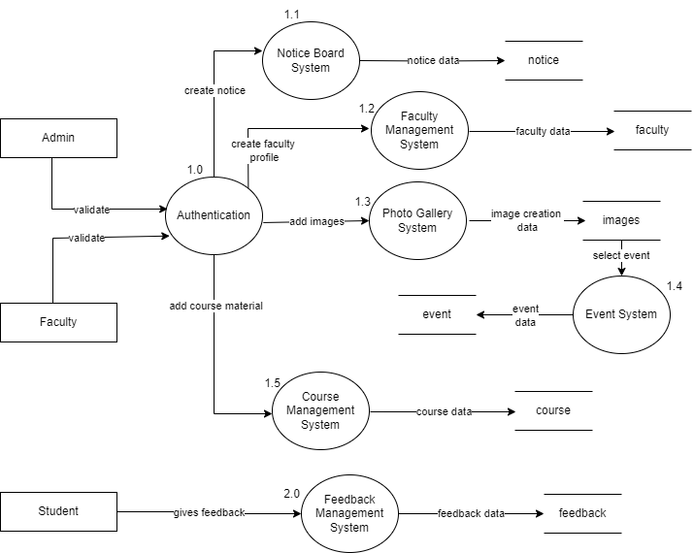
Data Flow Diagram (Level - 1)

Slide 12
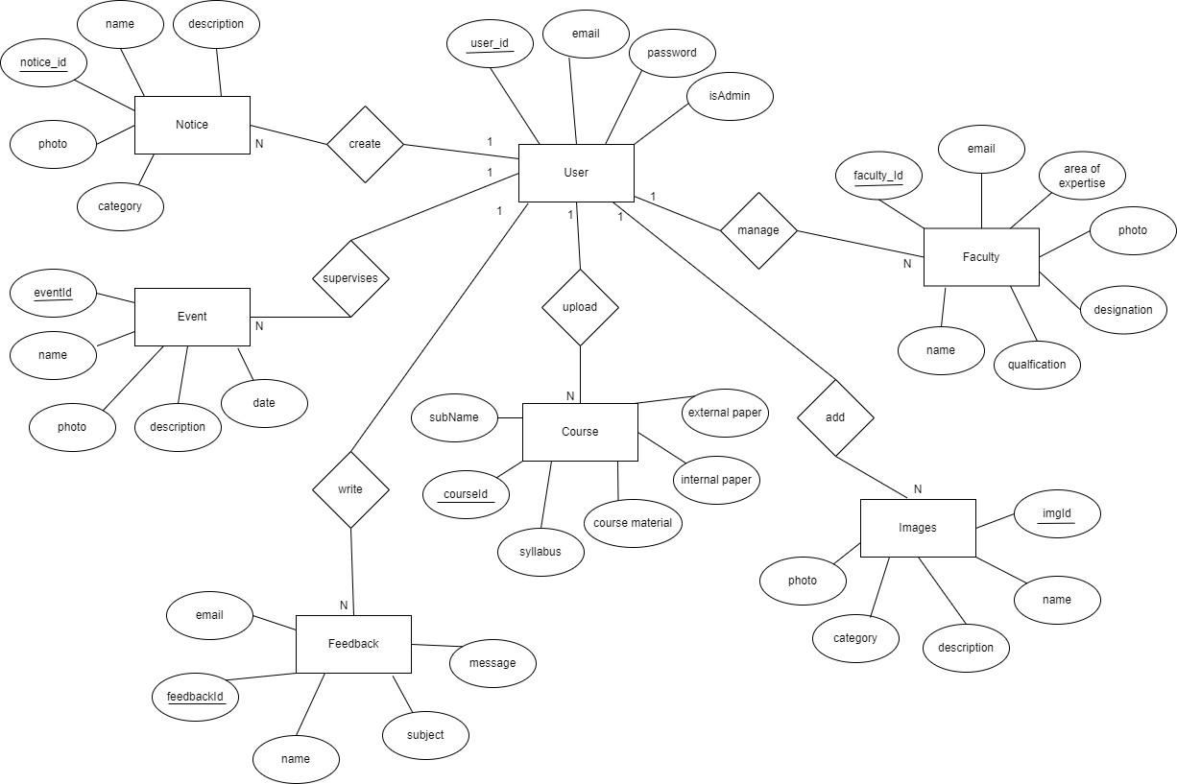
Entity-Relationship (E-R) Diagram

Slide 13
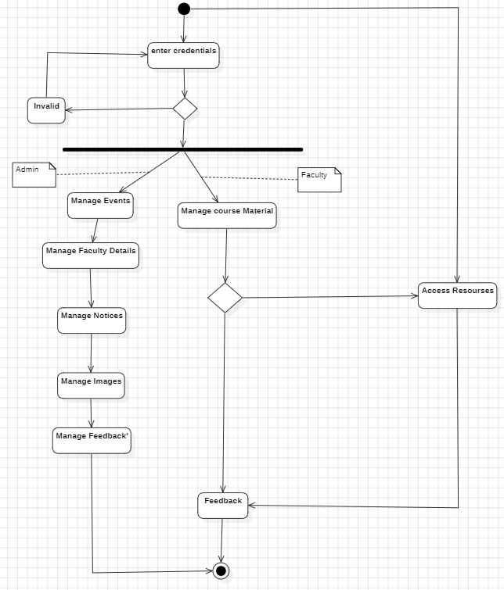
Activity Diagram

Slide 14
Screenshots

Slide 15
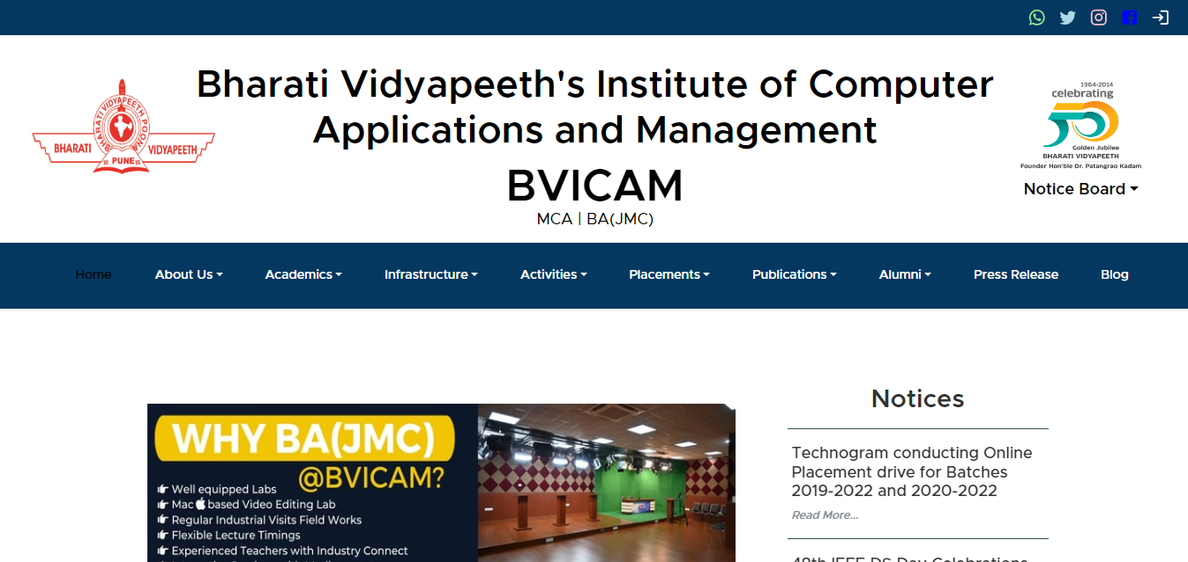
Screenshot – 1: Homepage

Slide 16
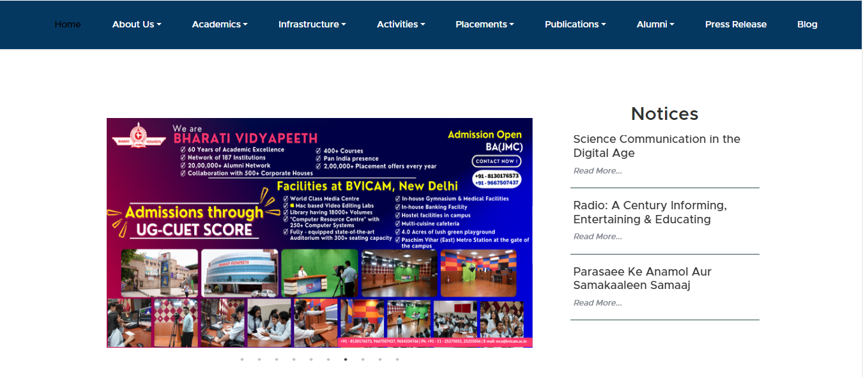
Screenshot – 2: Homepage

Slide 17
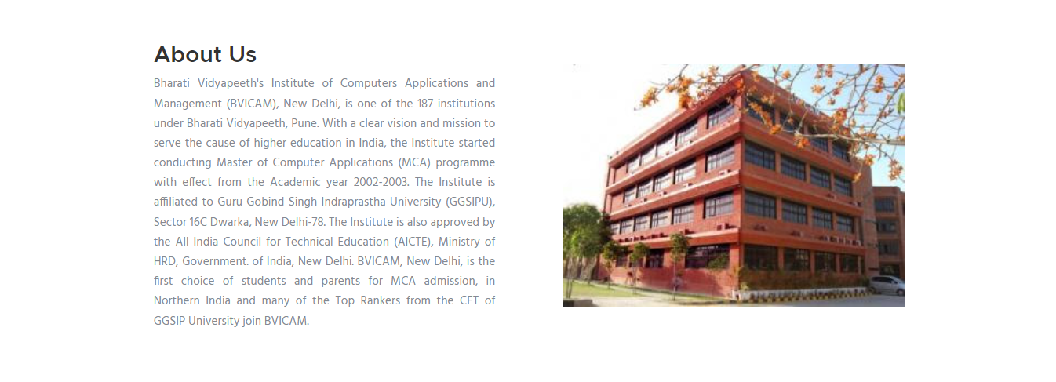
Screenshot – 3: Homepage

Slide 18
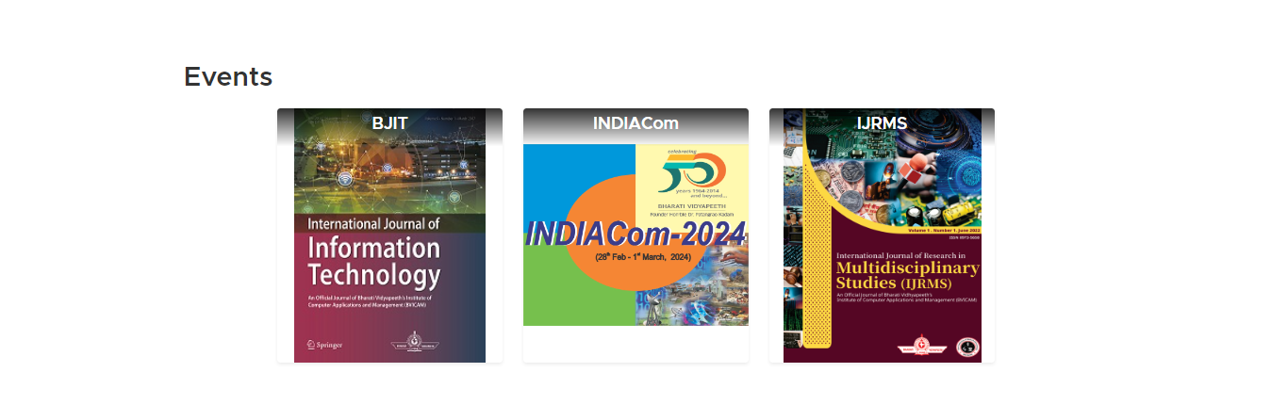

Screenshot – 4: Homepage

Slide 19
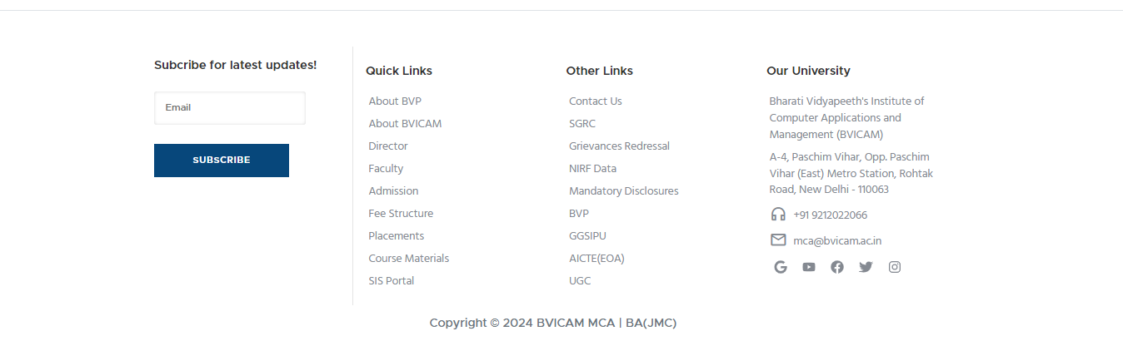
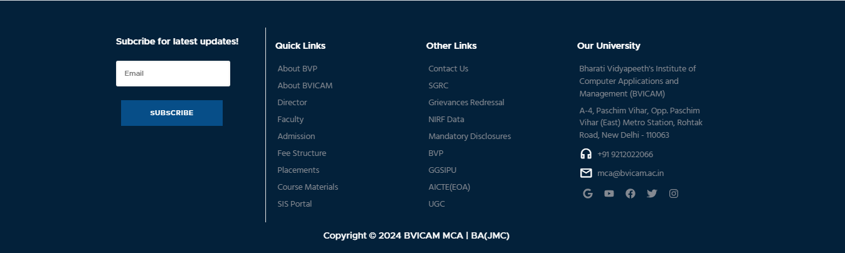
Screenshot – 5: Homepage

Slide 20
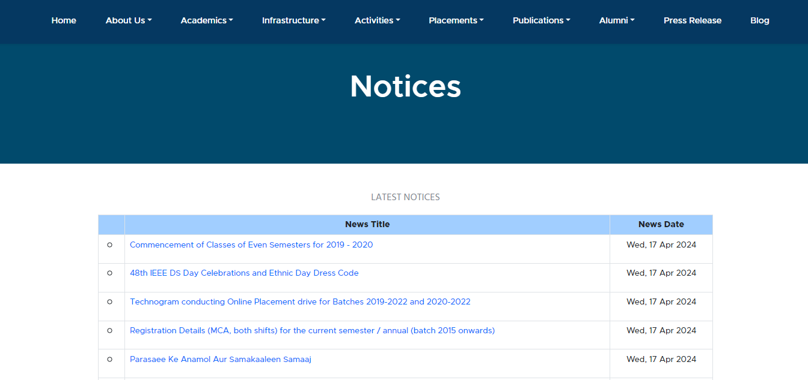
Screenshot – 6: Notices Page

Slide 21
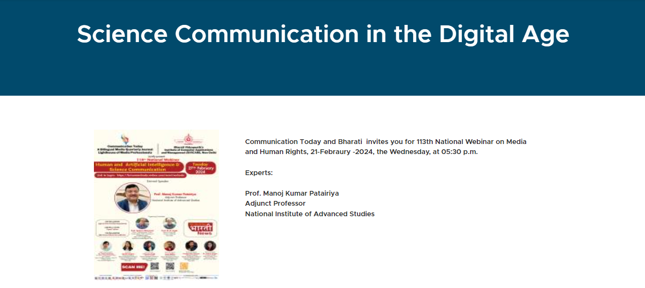
Screenshot – 7: Notice (with image)

Slide 22
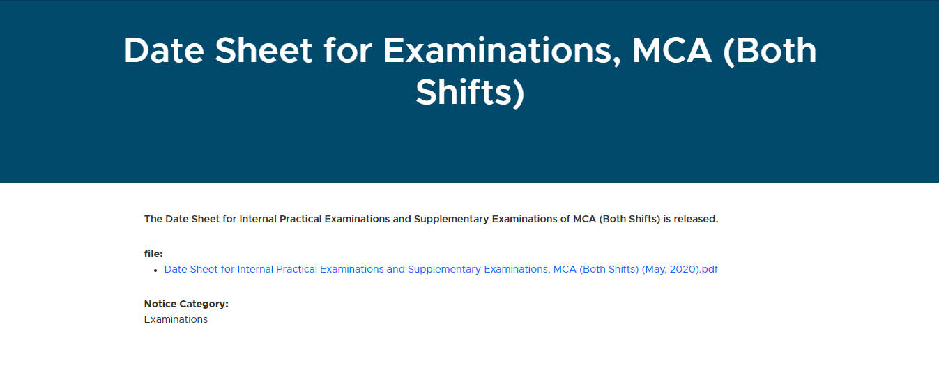
Screenshot – 8: Notice (with file)

Slide 23
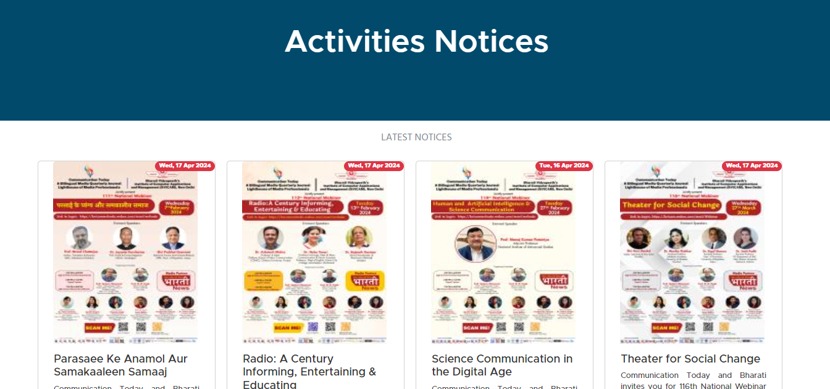
Screenshot – 9: Types of Notices

Slide 24
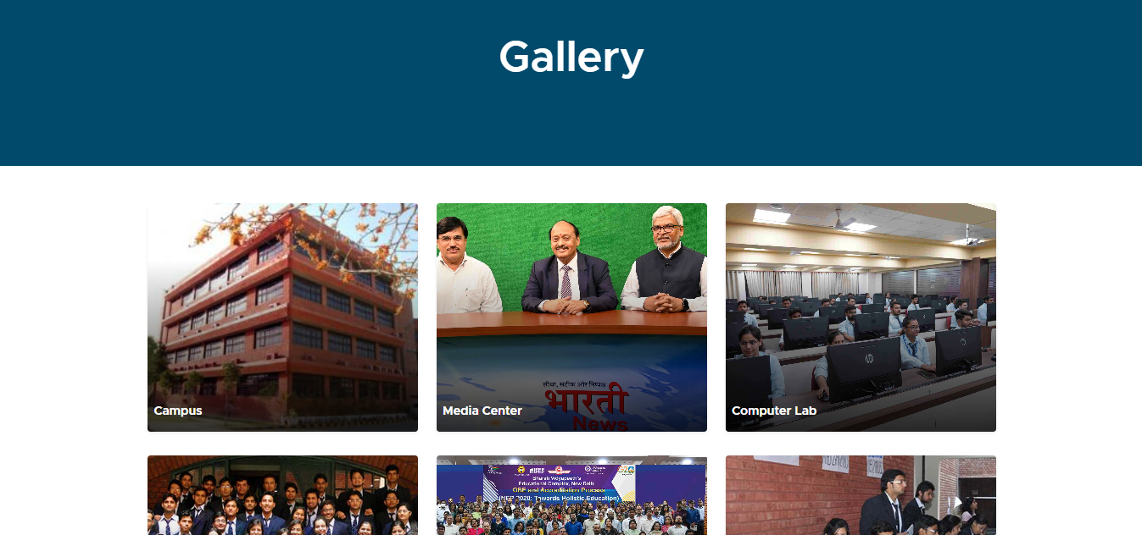
Screenshot – 10: Gallery

Slide 25
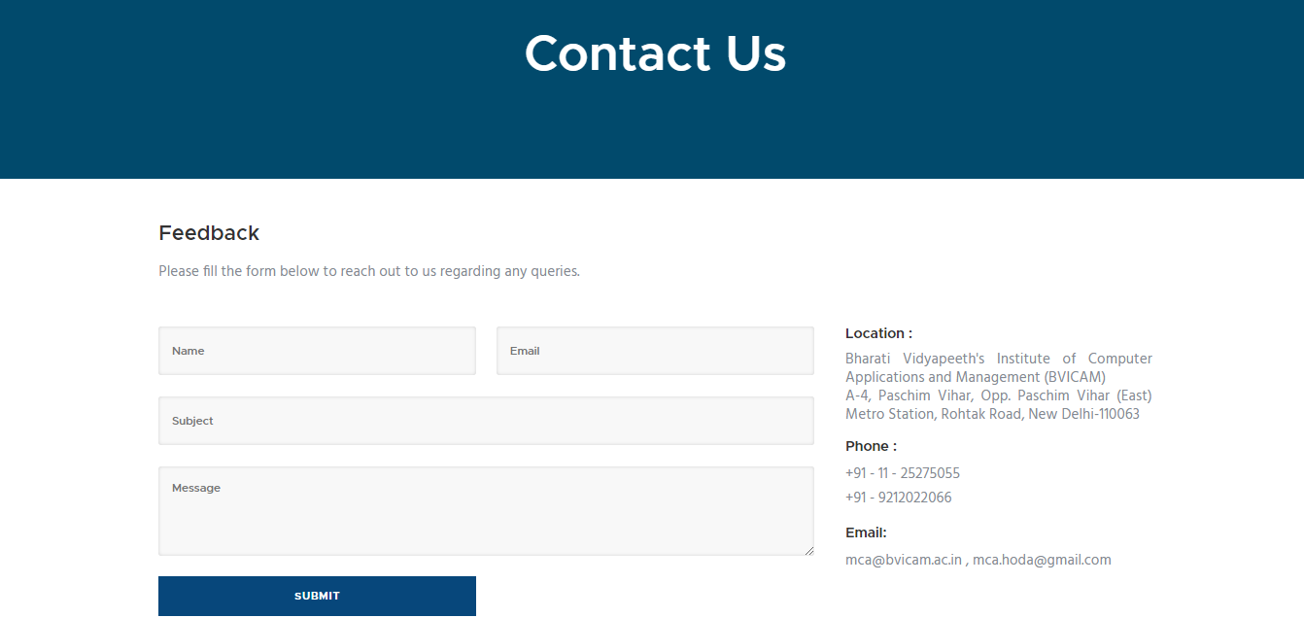
Screenshot – 11: Feedback

Slide 26
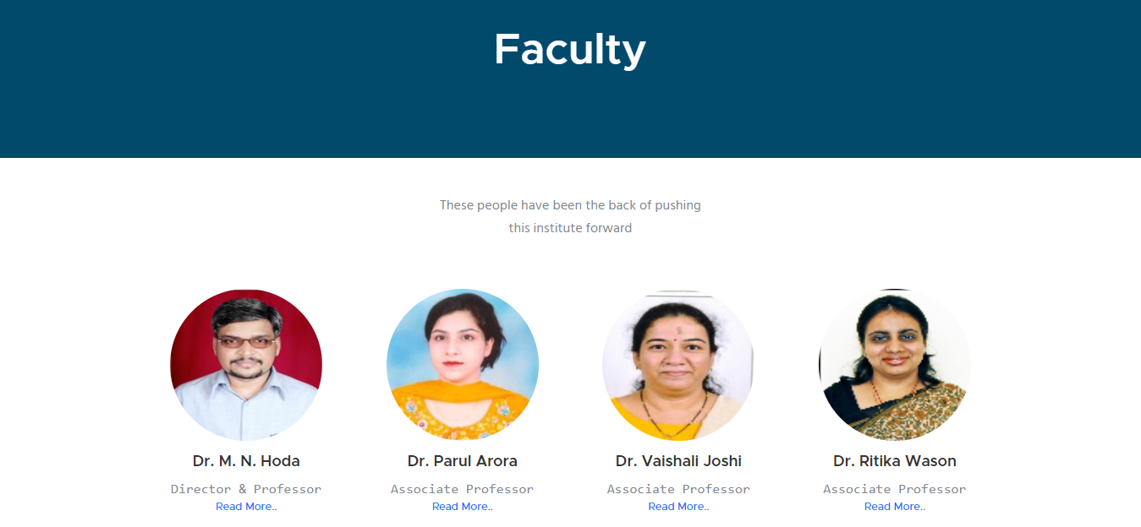
Screenshot – 12: Faculty Page

Slide 27
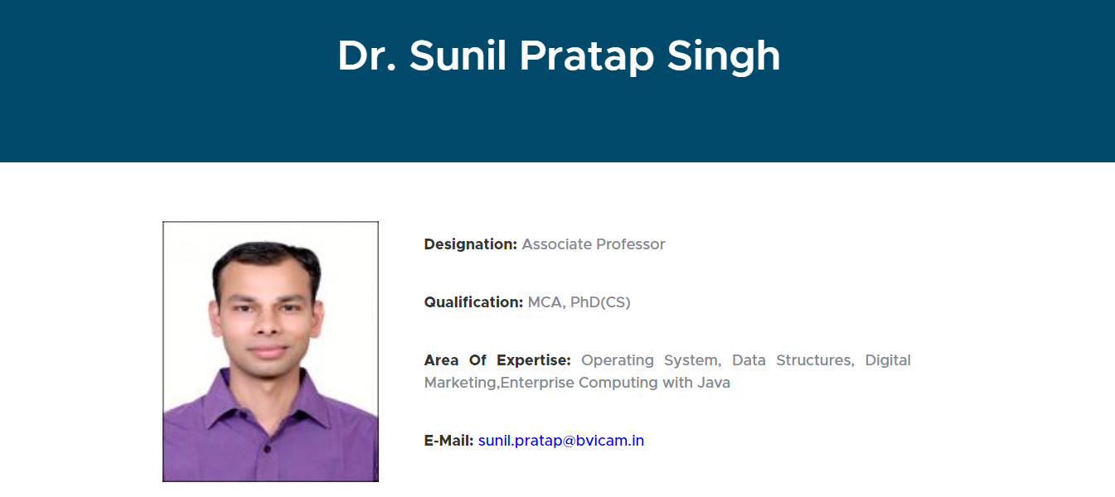
Screenshot – 13: Faculty Details

Slide 28
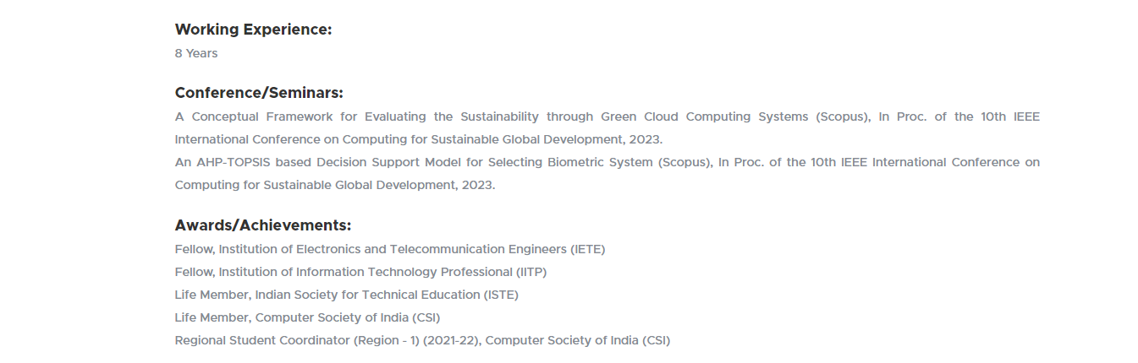
Screenshot – 14: Faculty Details

Slide 29
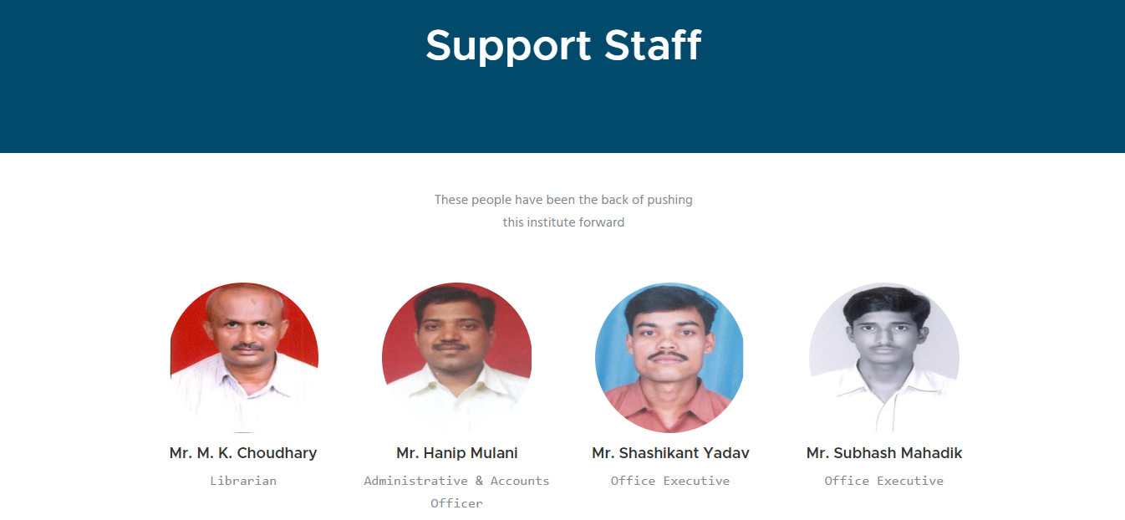
Screenshot – 15: Support Staff Page

Slide 30
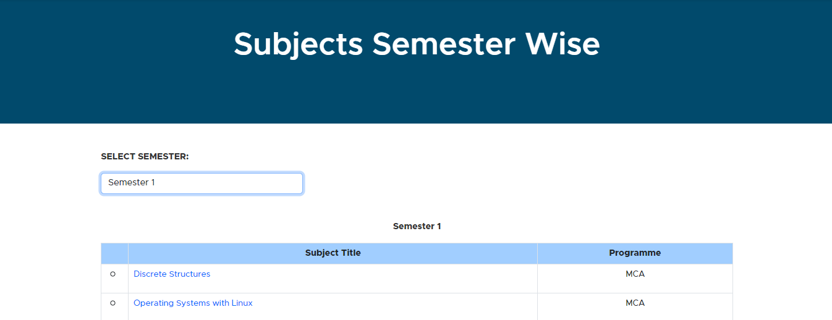
Screenshot – 16: Subjects List

Slide 31
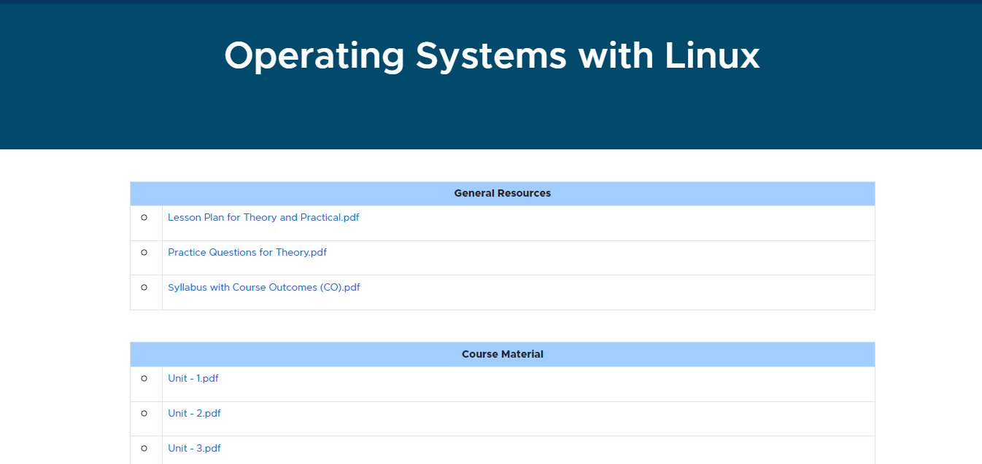
Screenshot – 17: Course Materials

Slide 32
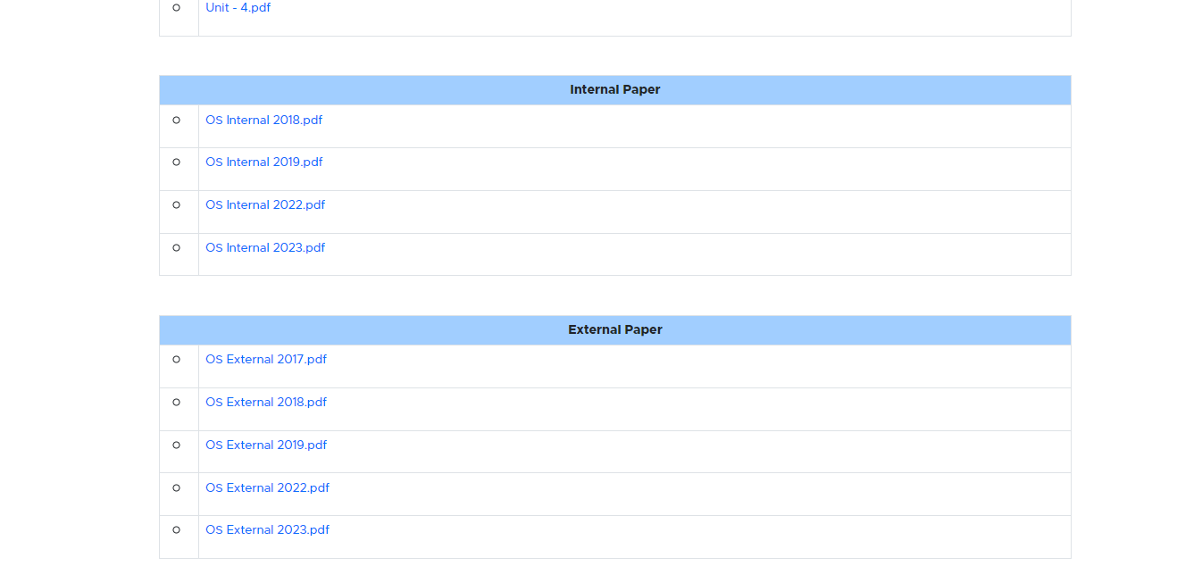
Screenshot – 18: Course Materials

Slide 33
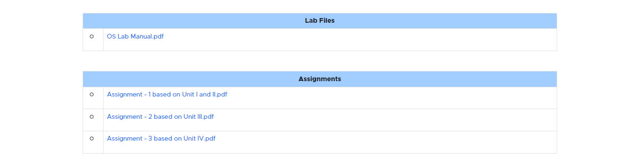
Screenshot – 19: Course Materials

Slide 34
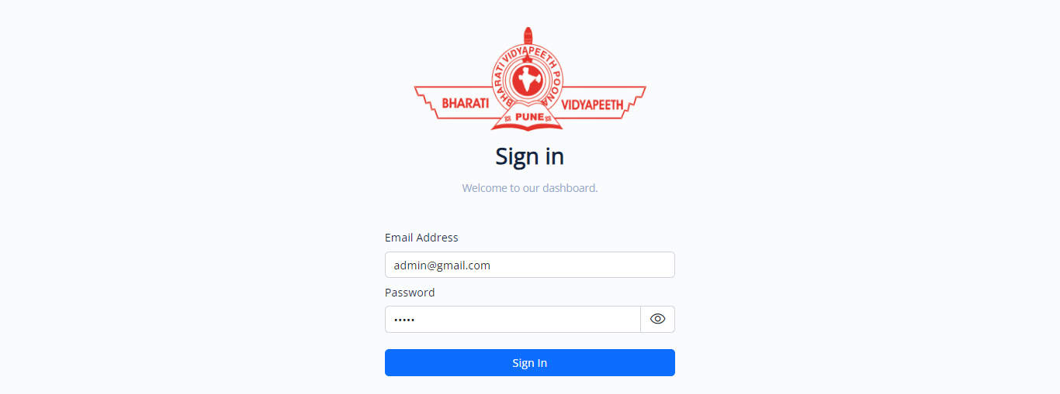
Screenshot – 20: Login Page

Slide 35
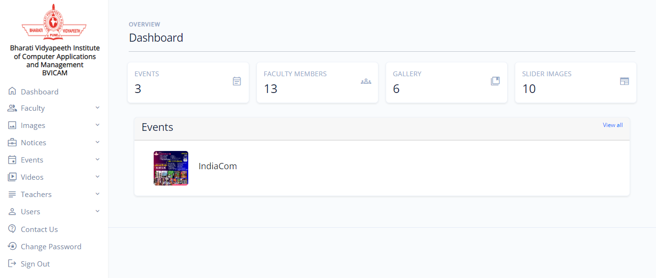
Screenshot – 21: Admin Dashboard

Slide 36
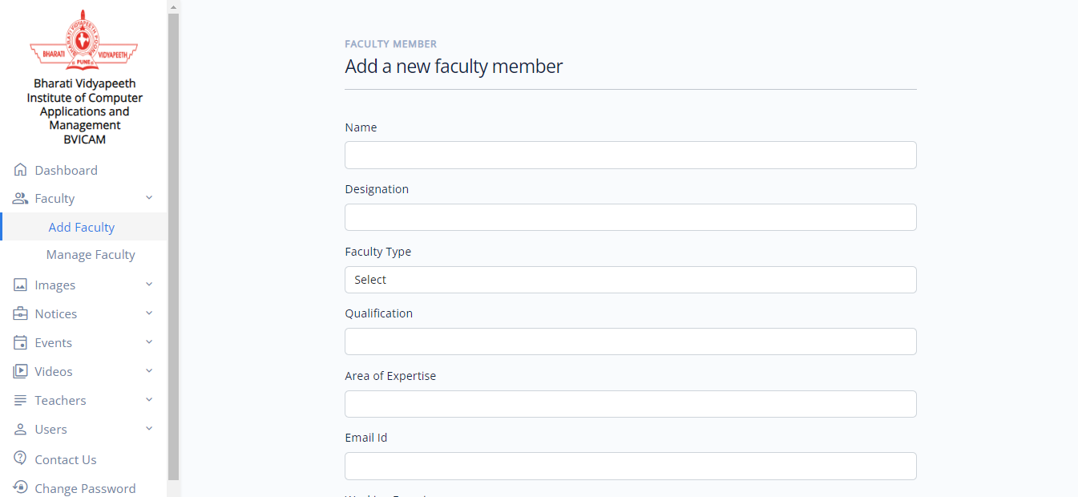
Screenshot – 22: Add Faculty Details

Slide 37
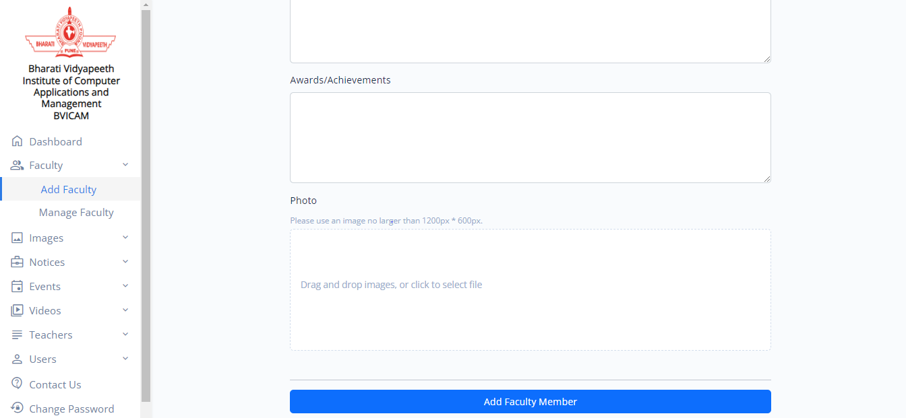
Screenshot – 23: Add Faculty Details

Slide 38
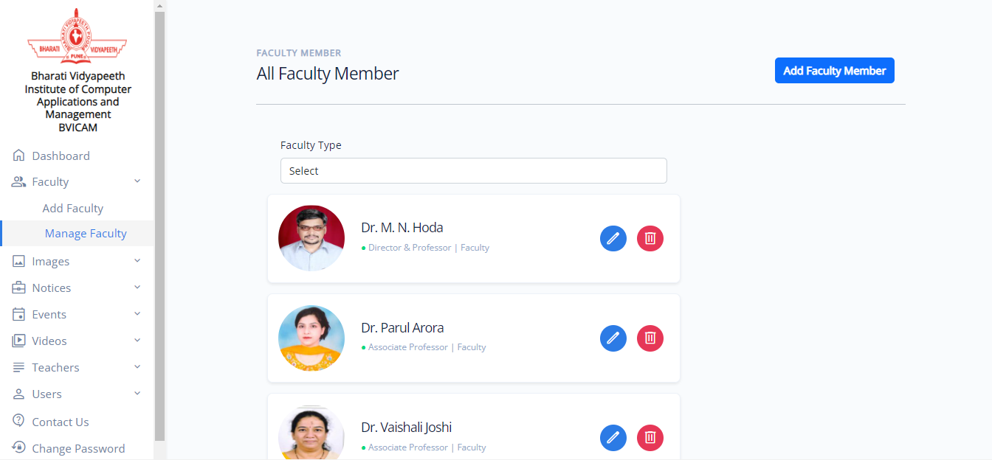
Screenshot – 24: Manage Faculty

Slide 39
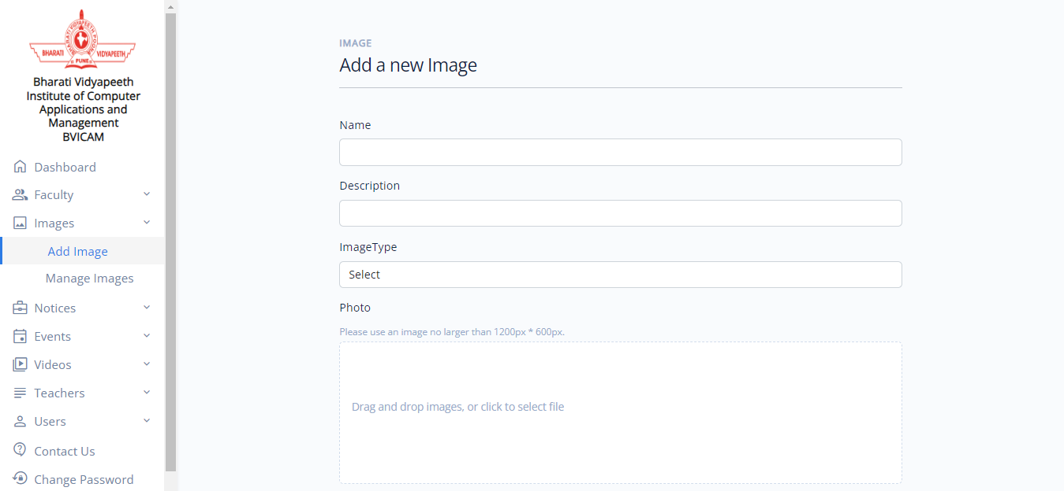
Screenshot – 25: Add Image

Slide 40
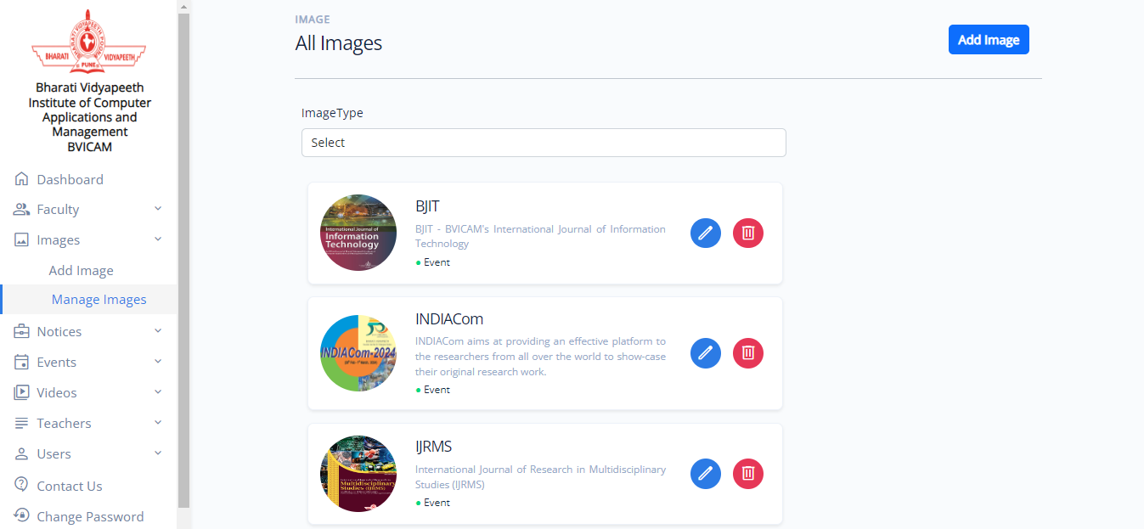
Screenshot – 26: Manage Images

Slide 41
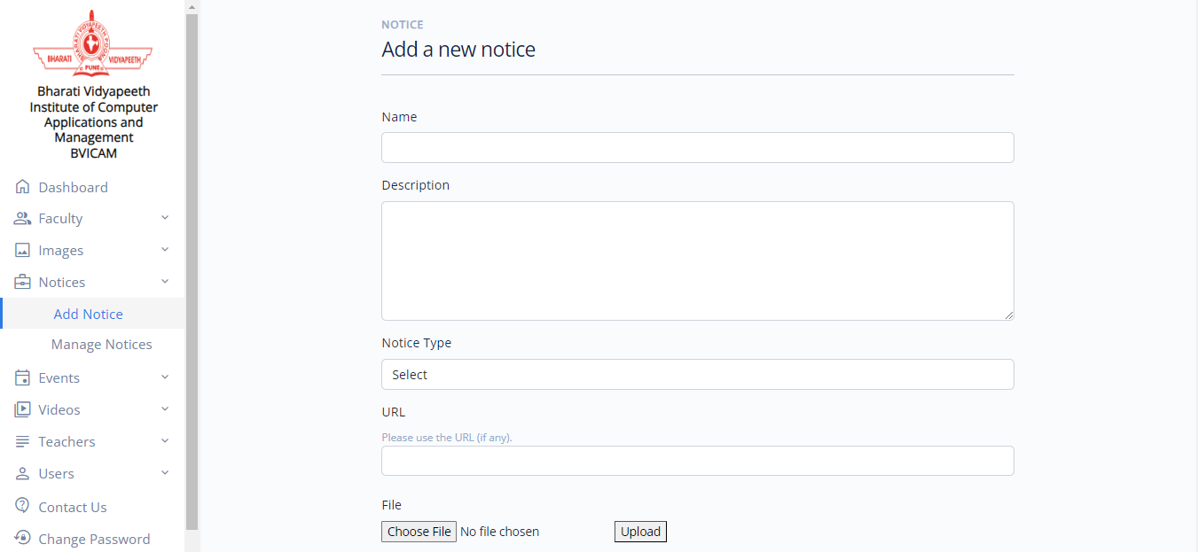
Screenshot – 27: Add Notice

Slide 42
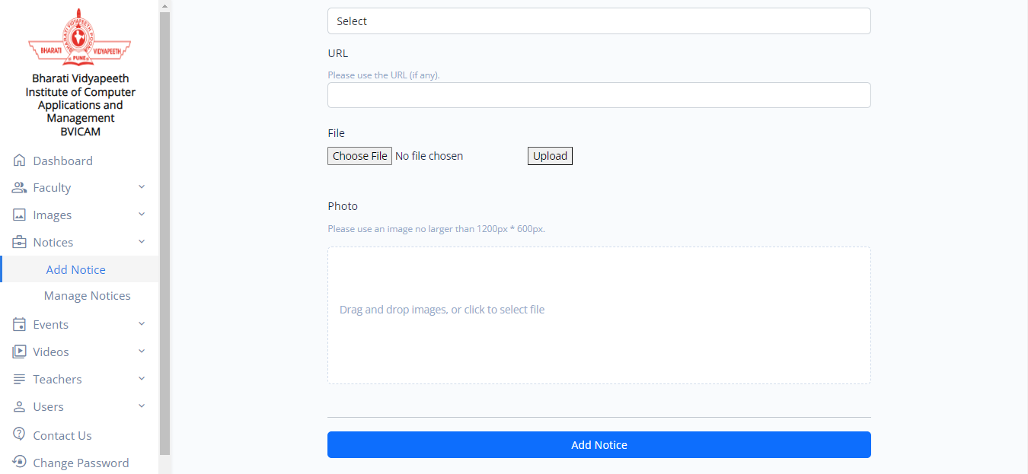
Screenshot – 28: Add Notice

Slide 43
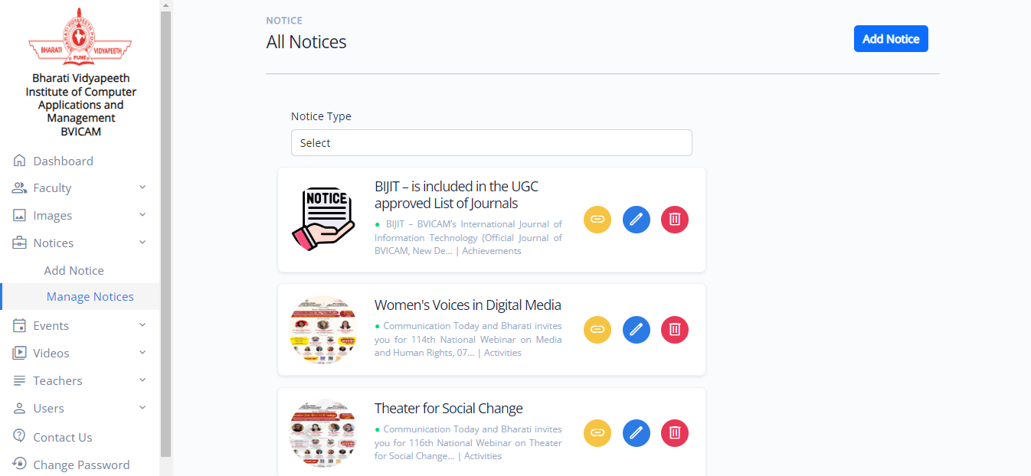
Screenshot – 29: Manage Notices

Slide 44
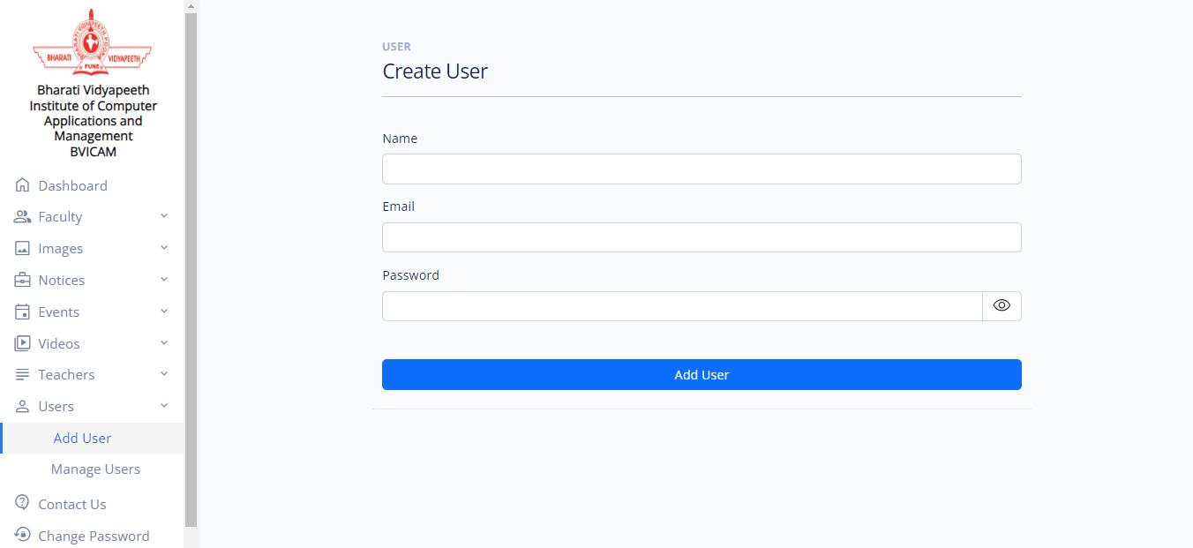
Screenshot – 30: Create User

Slide 45
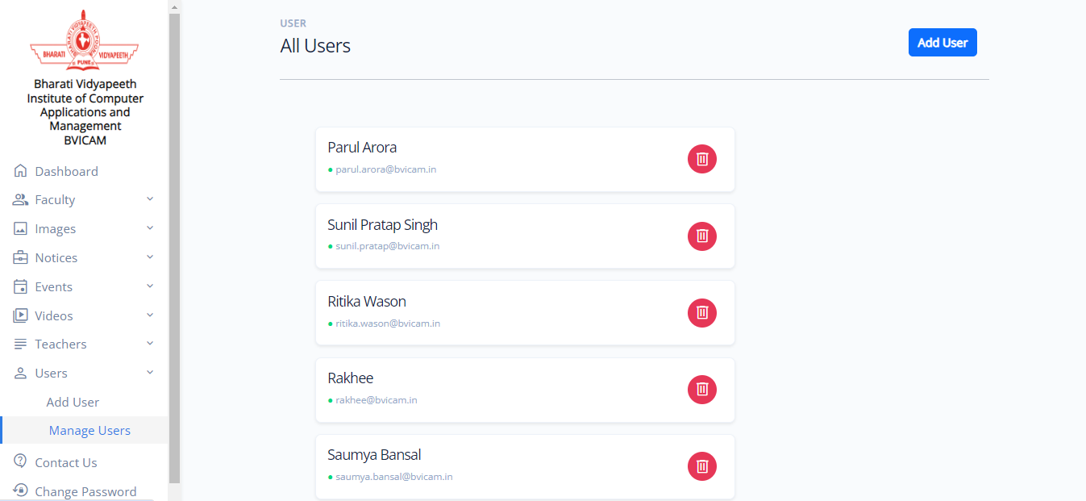
Screenshot – 31: Manage Users

Slide 46
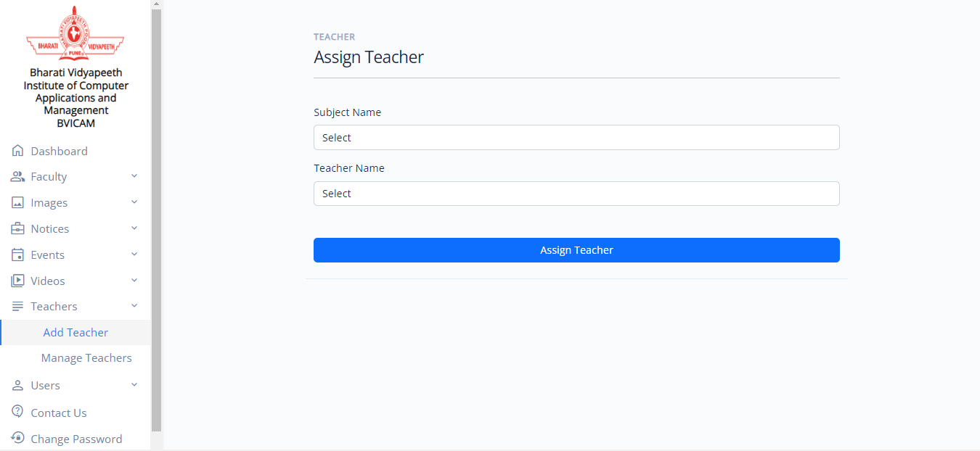
Screenshot – 32: Assign Teacher

Slide 47
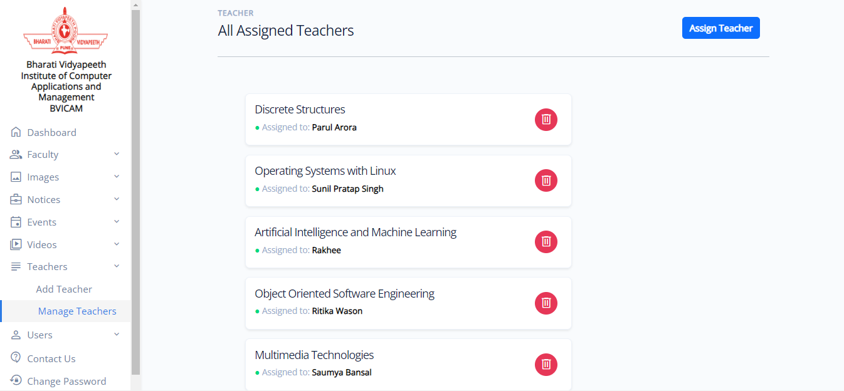
Screenshot – 33: Manage Teachers

Slide 48
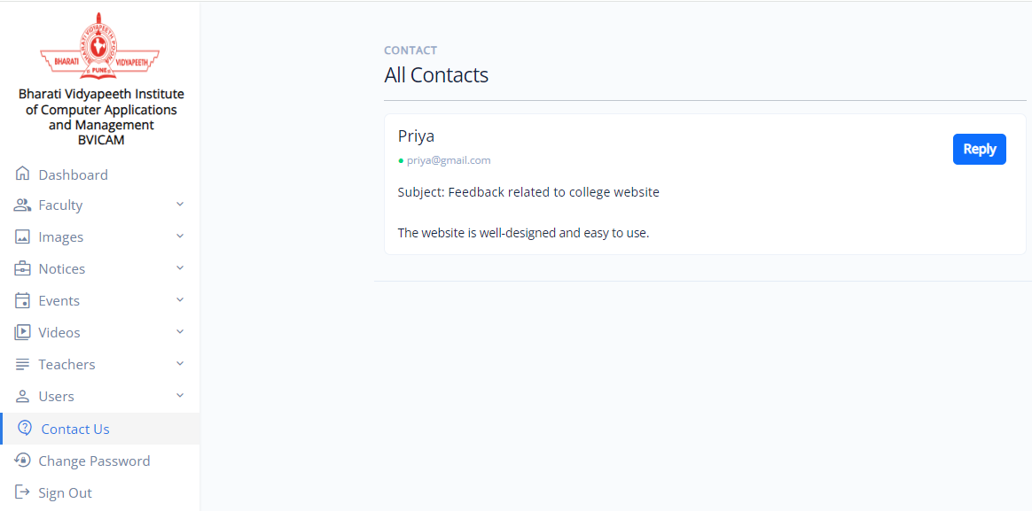
Screenshot – 34: Contact Us Details

Slide 49
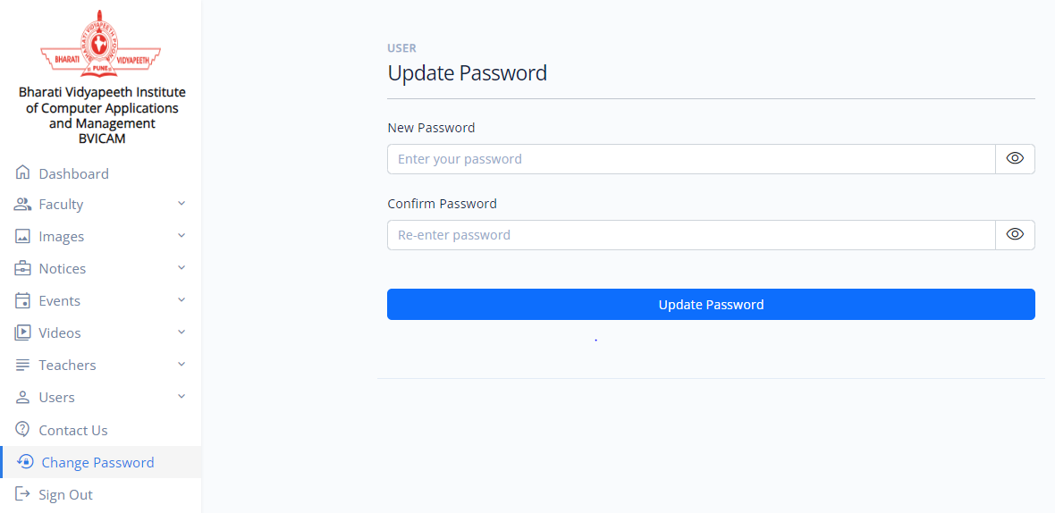
Screenshot – 35: Change Password

Slide 50
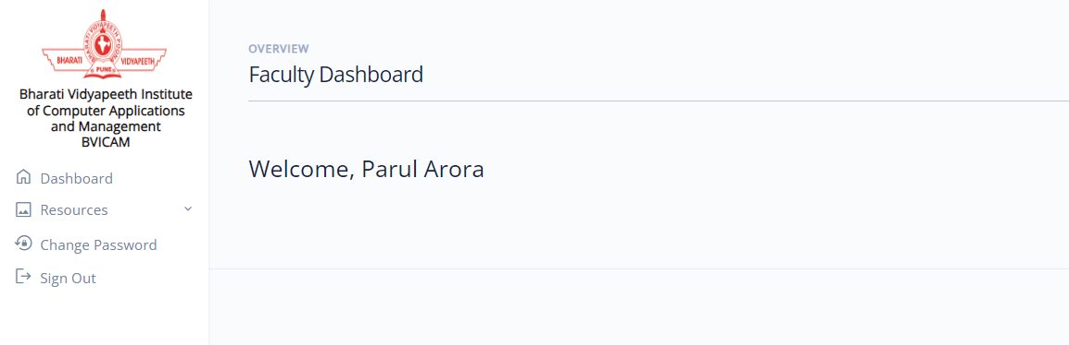
Screenshot – 36: Faculty Dashboard

Slide 51
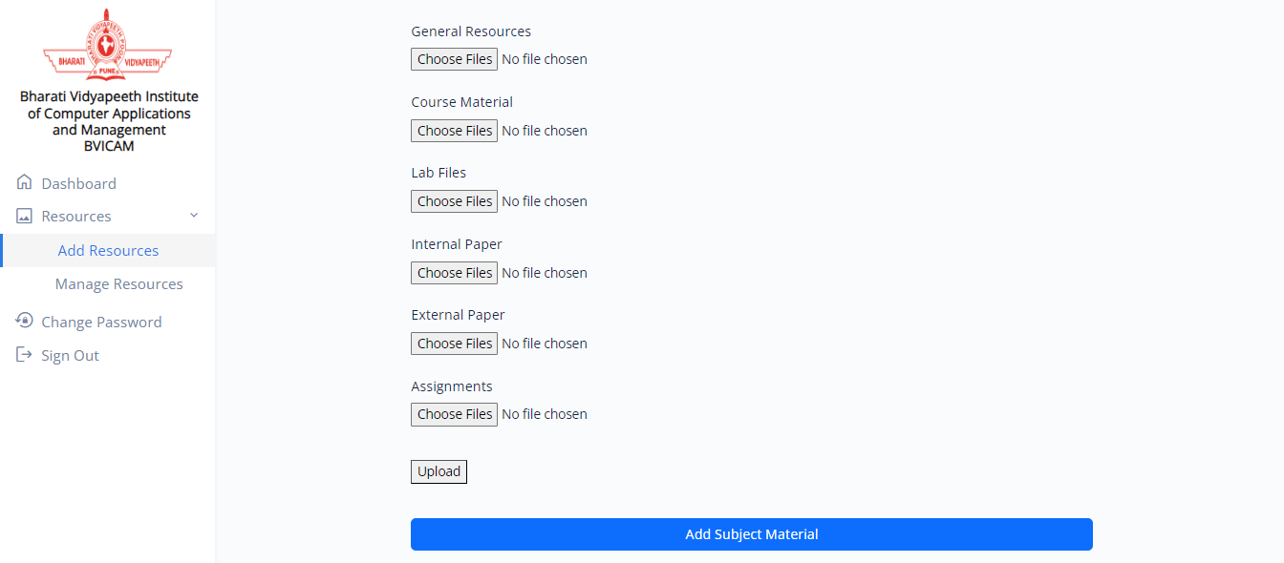
Screenshot – 37: Add Subject Material

Slide 52
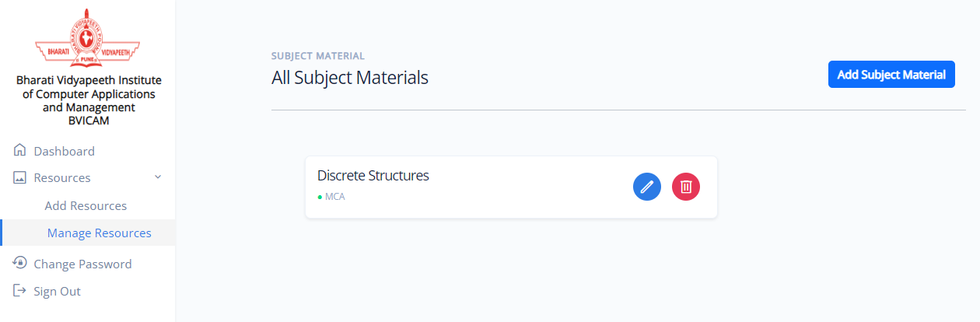
Screenshot – 38: Manage Subject Material

Slide 53
Testing of the Project
Id | Test Case Description | Test Case Input | Test Results |  | Status | Corrective Measure
 |  |  | Expected | Actual
1. | Admin Login | Email Id and password | Successfully logged in | Successfully logged in | Pass | None
2. | Notice Details | All the fields are required | Data inserted successfully | Data inserted successfully | Pass | None
3. | Staff Details | All the fields are required | Data inserted successfully | Data inserted successfully | Pass | None
4. | Images | All the fields are required | Data inserted successfully | Data inserted successfully | Pass | None
5. | Feedback | A string of message having characters but not empty string | Feedback is successfully submitted | Feedback is successfully submitted | Pass | None

Slide 54
Testing of the Project
Id | Test Case Description | Test Case Input | Test Results |  | Status | Corrective Measure
 |  |  | Expected | Actual
6. | Events | All the fields are required | Events added | Events added | Pass | None
7. | Notice Category | All the fields are required | Organize notices into distinct categories | Organize notices into distinct categories | Pass | None
8. | Course Details | All the fields are required | Data inserted successfully | Data inserted successfully | Pass | None
9. | Faculty Login | Username and password | Successfully logged in | Successfully logged in | Pass | None
10. | Faculty Details | All the fields are required | Data inserted successfully | Data inserted successfully | Pass | None

Slide 55
Conclusion
In conclusion, the development of this college website project has been a comprehensive endeavour aimed at enhancing the digital presence and functionality of our institution. Through planning, design, and implementation, we are on the way to create a user-friendly platform that serves as a centralized hub for students, faculty, staff, and prospective members of our community.
Through collaborative efforts and meticulous attention to detail, we are shaping a platform that will serve as a dynamic gateway to our college's offerings, resources, and vibrant community.
We embraced emerging technologies and best practices to create a user-centric website that reflects our college's ethics and values. From designing intuitive navigation to integrating interactive features, every aspect of the website has been thoughtfully crafted to enhance the user experience and streamline access to information.

Slide 56
Future Scope
The future scope presents exciting possibilities for expansion and adaptation of latest technologies to our college website that can significantly enhance user experience and engagement. Key areas of potential development include:
Alumni Engagement Platform: Create an interactive platform for alumni to reconnect with the college community, share career experiences, mentor current students, and contribute to institutional initiatives. This platform could feature alumni directories, event invitations, and collaborative projects to foster a strong alumni network and promote lifelong connections.
Virtual Campus Tours: Develop virtual campus tours using 360-degree panoramic images, videos, and interactive maps to provide prospective students and parents with a comprehensive view of the college facilities, infrastructure, and amenities.
Integration with Emerging Technologies: Explore the integration of emerging technologies such as artificial intelligence (AI), machine learning (ML), augmented reality (AR), and virtual reality (VR) to enhance various aspects of the website, including adaptive learning experiences, virtual labs, and interactive simulations.

Slide 57
Bibliography
Books:
React In Action by: Mark Tielens Thomas
Road to learn React: Robin Wipruch
Websites:
https://reactjs.org/docs/getting-started.html
https://sass-lang.com/documentation/
https://reactrouter.com/en/main
https://nodejs.org/en/docs/
https://www.mongodb.com/docs/
https://stackoverflow.com/

Slide 58


